Slide 1

Welcome
Police Reform – Community / Stakeholders Meetings
Sheriff Brooks J. Bigwarfe
October 13th, 2020 October 21st, 2020

Slide 2
Agenda
Team Members & Stakeholders - Introductions
Ground Rules
Why are we here? Police Reform, 4 Step Process
Overview of Sheriff’s Office Operations
Police Reform Criteria – Input/Questions
Next Steps- Future Events – October 21st, 2020
Ending Remarks

Slide 3
Introductions
Sheriff
Undersheriff
Police Reform Team
Stakeholders

Slide 4
Ground Rules
Meetings will start promptly
Respect other people’s opinions
Stay on topic
Provide specific examples from our community
Be respectful of people’s time
Meeting will end promptly

Slide 5
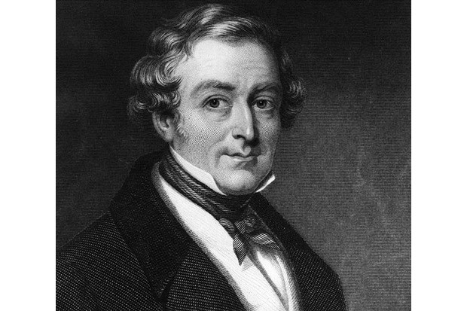
Sir Robert Peel
“ The Ability of the police to perform their duties is dependent upon public approval of police existence, actions, behavior and the ability of the police to secure and maintain public respect.” (1829)

Slide 6
POLICE REFORM
Compliance with the Governors' Executive Order 203 – New York State Police Reform and Reinvention Collaborative
Accordingly, the New York State Sheriffs Association is recommending that Sheriffs voluntarily and proactively undertake the process of review, consultation and planning outlined in the Governor's Executive Order 203, engaging their communities and stakeholders in the process
Even the best agencies can find opportunities for improvement, and this process should not be viewed negatively

Slide 7
EXECUTIVE ORDER 203, Step 1
The county must perform a comprehensive review of current Sheriff’s Office deployments, strategies, policies, procedures and practices.
This was initiated by the Sheriff providing the county legislative body with an overview on the Executive Order 203 before the full Legislative Board on July 13, 2020.

Slide 8
EXECUTIVE ORDER 203, Step 2
The chief executive officer of the county is tasked to call together the Sheriff and stakeholders in the community to develop a plan for any needed improvements to current deployments, strategies, policies, procedures and practices.
We use our knowledge, experience and professional judgement, combined with available information, data, analysis and research to develop our St. Lawrence County Sheriff’s Office policing strategies, policies and procedures. Some of the relevant strategies, policies and procedures and related issues are set forth in the next slides for community discussion and comment.

Slide 9
EXECUTIVE ORDER 203, Step 3
The plan shall be offered for public comment, and after consideration of such comments, shall be ratified by Resolution or adopted by Local Law, no later than April 1, 2021.
The public comment on any proposed plan could come in the form of written comments or at a public hearing (especially if proceeding Local Law) at a meeting of the legislative body. Public comment will be accepted at a meeting being held on October 21, 2020.

Slide 10
EXECUTIVE ORDER 203, Step 4
The county shall transmit a certification to the Director of the Budget that the process has been complied with and the Resolution or Local Law has been adopted.

Slide 11
PLAN DEVELOPMENT
In developing a plan for any needed improvements the following should be considered:
1. Education 2.Training 3.Supervision
  Evidence-based policing strategies, including use of force policies
  Implicit bias awareness training
  De-escalation training and practices
  Model policies and guidelines promulgated by the DCJS
  Standards promulgated by the Law Enforcement Agency Accreditation Council

Slide 12
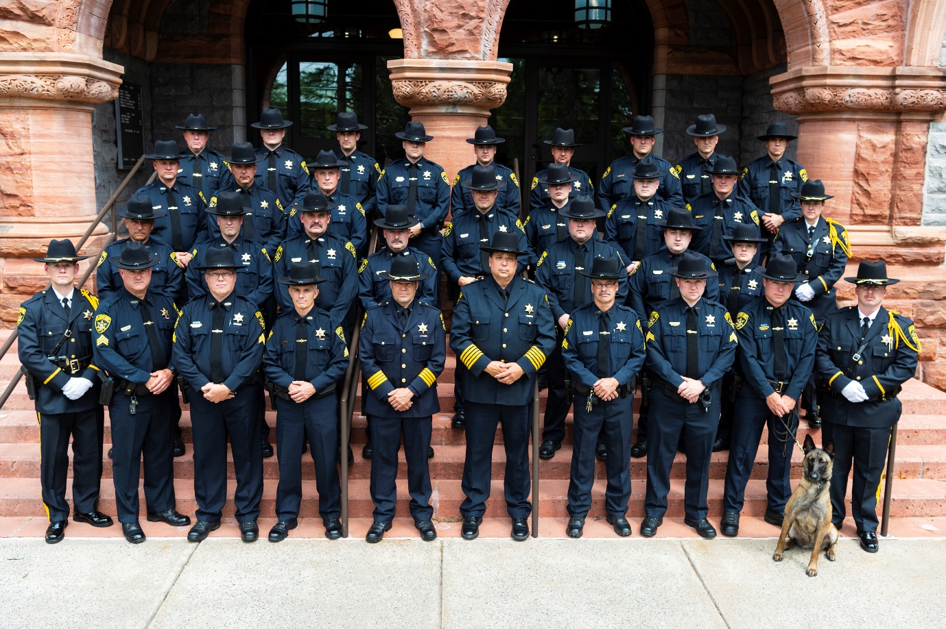
SHERIFF’S OFFICE
The St. Lawrence County Sheriff’s Office serves the Law Enforcement needs of all the citizens of the County, and strives to do so in a professional manner, respecting the rights of all our citizens without regard to race, color, nationality, creed, gender or sexual orientation. Our policies and procedures are devolved and carried out with that goal in mind and our 33 Deputy Sheriffs are selected, trained and supervised to complete this mission statement.

Slide 13
DEPUTY DEPLOYMENT
How and where we currently deploy our Deputies:
Deputies are deployed to 4 different zones in the County.
Zones are separated geographically for consideration of response times.
St. Lawrence County Sheriff’s Office strives to practice community oriented policing assigning Deputies to the areas where they live.
No Quotas! We strive for productive “contacts” with the people we serve.

Slide 14
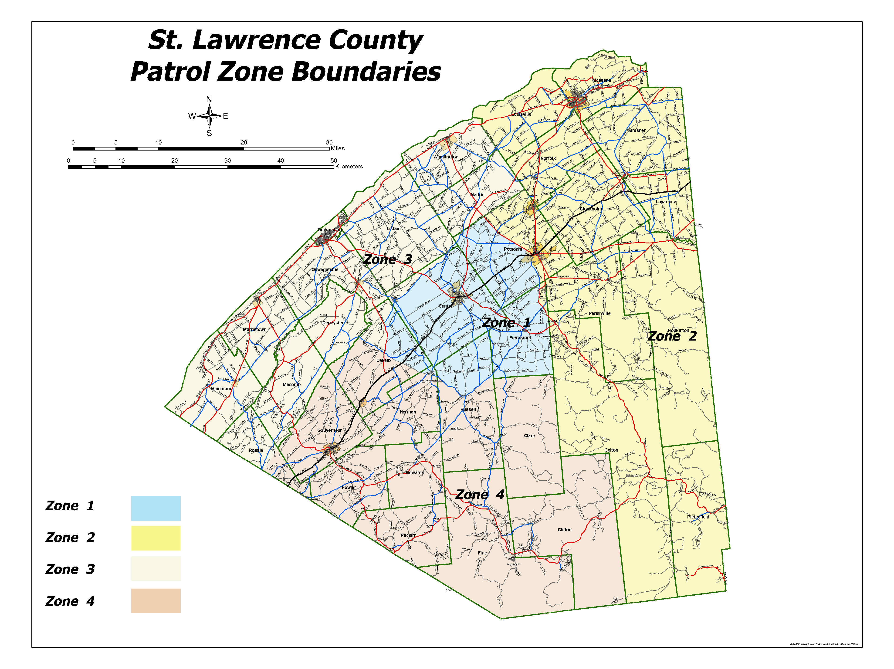

Slide 15
DEPUTY DEPLOYMENT
School Safety Initiative -
Deputies are there to Support Safety, Not Discipline
Presence in Schools – 478 School checks in 2019.
Familiar with Students and staff members alike.
Layout of Schools in case of emergency.
Each Deputy has in-car computer that has school maps at their fingertips.
Explored SRO Programs – Costs $$
Additional Input?

Slide 16
DEPUTY DEPLOYMENT
Department of Social Services:
Mental Health Assistance – Pickup Orders
Substance Abuse Calls
Homeless- Assist with placement and transportation
Assist with custody disputes

Slide 17
DEPUTY DEPLOYMENT
Project LiveSaver
Pharmaceutical drop off / take back
Safe Child I.D.
Elder Wellness Checks / assist with Meals on Wheels program
CAC Member / Domestic Violence Cooperative / VINE Program
Sheriff’s Summer Camp
Yellow DOT Program
Snowmobile / Boat Patrols
Enhanced DWI / Stonegarden Patrols

Slide 18
DETECTIVE DEPLOYMENT
1 Detective Sergeant supervises 4 Detectives.
1 Detective assigned to each of the 3 Zones that are familiar with their area of responsibility.
1 Detective assigned to lead the Countywide Drug Task Force.
Major crimes investigations.

Slide 19
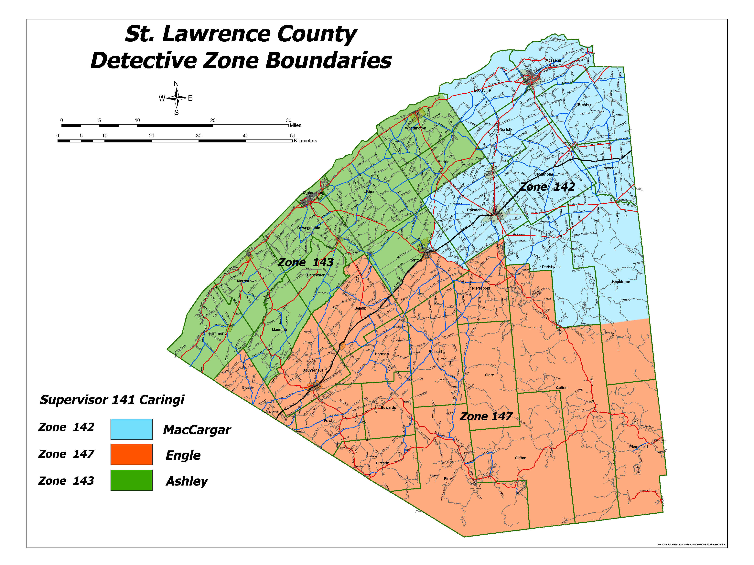

Slide 20
ACCOMPLISHMENTS TO DATE
  Met with Chiefs, State Police and SUNY Chiefs/SLU Director
    Planned for college forums with their staff and police reform as a whole.
    Discussed training and educational components.
  College Forum Group Meetings (all four colleges)
    Sheriff, Chiefs, College presidents, Mayors, Town Supervisors, others
      Discussed college issues and making plans for fall semester
      Possible student forums with law enforcement
  Met with Professors of Potsdam State
    Discussed national and local issues pertaining to Police Reform
  Training / Educational components

Slide 21
USE OF FORCE
Our Use of Force policy is available on the St. Lawrence County government website as well as the St. Lawrence County Sheriff App.
Annual review is conducted on our Use of Force policy.
Use of Force policy is modeled after the Municipal Police Training Councils’ policy. This is required by the New York State Accreditation Program.
Last review of our Use of Force policy was conducted by Accreditation auditors in July of 2020.
Use of Force Reports are submitted electronically to DCJS by the Undersheriff when outlined criteria is met.

Slide 22
PROCEDURAL JUSTICE
The St. Lawrence County Sheriff’s Office has several policies that promote procedural justice. Listed below are a few of those policies:
Policy Standard #3, Section 11.25 , Letter C states: “Officers shall not express any prejudice concerning race, religion, politics, national origin, lifestyle or other personal characteristics.”
Policy Standard #3, Section 11.26 states: “When any person applies for assistance, advice, or makes a complaint whether by telephone or in person, all pertinent information will be obtained in an official and courteous manner.”

Slide 23
PROCEDURAL JUSTICE
Policy Standard #3, Section 11.24 states: “Officers shall courteously and promptly record in writing any complaint made by a citizen against any Officer of the St. Lawrence County Sheriff’s Office.”
  TRANSPARENCY- Is a Priority
  Complaint made to on duty Supervisor
  Forwarded to administration if warranted
  Further investigation conducted by administration
  In the event there is alleged Criminal Activity, DA Consulted
  Attorney General will be notified for any unarmed suspect shootings

Slide 24
PROCEDURAL JUSTICE
  Policy Standard #7, Section 19.01 states: “The St. Lawrence County Sheriff’s Office recognizes the importance of maintaining an atmosphere of openness and cooperation within the community. The Sheriff’s Office actively seeks to establish cooperative relationships and to keep the community informed on matters of public interest.”
    Sheriff App / Notifications –Emergency Banner
    Facebook / Twitter
    Media Releases
    Open Door Policy

Slide 25
ANTI-BIAS AND ANTI-DISCRIMINATION
The St. Lawrence County Sheriff’s Office practices anti-bias and anti-discrimination policing. We hold our Officers to a high standard and require our Officers to attend the latest available trainings to include:
Academy Training (additional training will be added for 2021 academy class)
Bias training / Diversity and Inclusion / Mental Health, others
On-Line Trainings
Fair and Impartial Policing
Refresher Trainings
Chief Mulkin – Bias training (completed)

Slide 26
DE-ESCALATION
All of our Officers are trained annually on de-escalation techniques.
Annual training consists of, but not be limited to, use of force, conflict prevention, conflict resolution and negotiation, and de-escalation techniques and strategies. This includes, but not limited to, interacting with persons presenting in an agitated condition and mental health emergencies.
Duty to intervene and prohibited conduct by other Officers.
Verbal Judo – Sheriff & Chief Murray Certified Instructors.
  Steps for De-escalation for traffic stops, complaints, other situations.
De-escalation is included in our use of force policy which is modeled after the Municipal Police Training Council use of force policy.

Slide 27
Hot Spot Policing
Meth Labs in St. Lawrence County

Slide 28
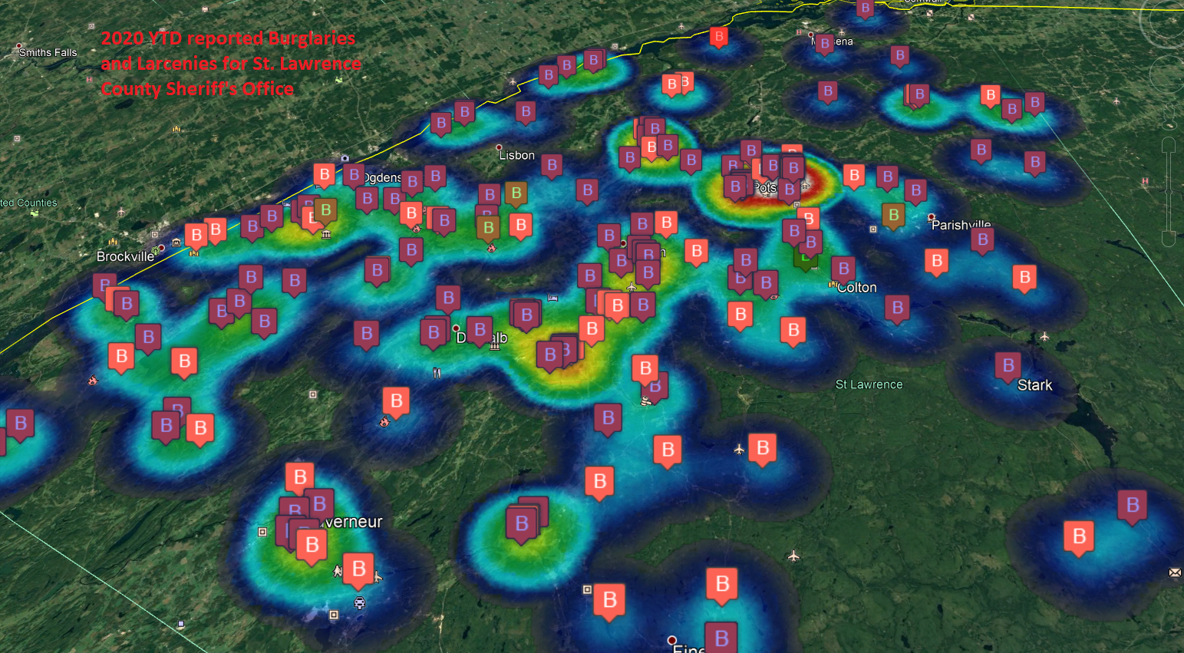
Hot Spot Policing

Slide 29
ACCREDITATION
  Accreditation means that our Sheriff’s Office has adopted and adheres to the best practices in policing as proscribed by the States Law Enforcement Agency Accreditation Council (Exceeds Municipal Police Training Committee Standards)
  Two-thirds of Sheriff Offices in NYS are accredited by DCJS
  NY Sheriffs have been, and continue to be, leaders in Police Accreditation
  Started in 1984 by NYS Sheriffs’ Association – proved so successful it was taken over by NYS and is now offered to all NY agencies.

Slide 30
ACCREDITATION
  Internal Yearly Review
  Re-Accreditation every 5 years by DCJS
  SLCSO has worked the past 1 ½ years to become accredited.
  Review on July 27th -WE MADE IT!- NYS Accredited on September 3rd, 2020.
  Completes or Exceeds many standards in new Police Reform criteria
  You see this throughout this presentation - ACCREDITATION

Slide 31
BODY CAMERAS
  Body Camera usage is currently in an implementation phase and a policy has been created. Started October 1st, 2020 for 30 day trial.
  New York State Police to be mandated for all uniform Troopers to wear body cameras.
  PPD / SUNY Canton only agencies in county that presently require Body Cameras
    PPD: $30,000 start up cost – several thousands / year maintenance
    Server / software / warranty / maintenance costs
  Cost analysis completed for Sheriffs Office (not required yet)
    $50,000-$70,000 (preliminary first year implementation estimate)
    Annual costs to be determined (server/cloud storage/maintenance costs)

Slide 32
Body CAMS
Transparency
Accountability
Data Collection / Retention / Documentation
Help confirm the the nature of events and supports accounts articulated.
Evidentiary purposes – corroborating
Use of Force issues
Civilian Complaints – Quicker Resolutions
Training Opportunities

Slide 33
Officer Evaluations
Annual Evaluations completed by supervising officers- ACCREDIDATION
    Mission Statement – (read and sign off)
~ Positives
~ Negatives
~ Improvements (review throughout the year)
~ Goals – Personal and Agency

Slide 34
Officer Wellness/ Well Being
Employee Mental Health Screening Prior to Employment - ACCREDIDATION
Employee Assistance Program – EAP
  Crisis Intervention
  Counseling
Chaplaincy Program
Extreme Circumstances- Allow Officers to change shifts for a period of time.

Slide 35
Repeal of 50-A
For many years, Public Officers Law 87 (2)(a) allowed covered entities to exempt disclosure of records if the records were “specifically exempted from disclosure by state or federal statute.”
Civil Rights Law 50-a has required that law enforcement personnel records be treated as confidential and not released to the public except as mandated by a lawful court order or the consent of the police officer who is the subject of the records.
On June 11th, 2020, the Governor signed legislation repealing New York Civil Rights Law 50-a, in turn, allowing the public to have access to the disciplinary records of law enforcement personnel.
This means: Law enforcement personnel records are no longer automatically exempt from disclosure.

Slide 36
Law Enforcement Misconduct
Investigative Office
Established the Law Enforcement Misconduct Investigative Office within the Department of Law which would investigate complaints, allegations of corruption, fraud, use of excessive force, criminal activity, conflicts of interest, or abuse in certain law enforcement agencies.
Requires every officer to promptly report to the Investigative Office any information concerning police corruption, fraud, use of excessive force, criminal activity, conflicts of interest or abuse by another officer or employee relating to his/her office or employment, or by a person having business dealings with a covered agency relating to those dealings.

Slide 37
Law Enforcement Misconduct
Investigative Office
An Officer’s known failure to report such information is cause for his/her removal.
Police agencies should adopt a policy and introduce education regarding the duty to report information to the investigative office.
Decertification of Police Officers with cause.
  Effective April 1st, 2021

Slide 38
Anti-Chokehold Act
Eric Garner Anti-Chokehold Act (Senate Bill 6670B/Assembly Bill 6144B) Effective June 12th, 2020.
Established the crime of aggravated strangulation PL. 121.13-A: for Police Officers where such Officer commits the crime of criminal obstruction of breathing or blood circulation or uses a chokehold or similar restraint and causes serious physical injury or death.

Slide 39
Anti-Chokehold Act
Reviewing the new standards provided by MPTC for change consideration.
Article VII, C sub 1 “Any application of pressure to the throat, windpipe, neck or blocking the mouth or nose of a person in a manner that may hinder breathing, reduce intake of air or obstruct blood circulation, is prohibited unless deadly physical force is authorized.”
  Defensive Tactics - training / education

Slide 40
Police Statistics and
Transparency Act
Requires reporting of criminal offenses and arrest-related deaths.
  Courts must compile and publish aggregate racial and other demographic data of all low-level offenses, including misdemeanors and violations.
  Police agencies are required to promptly report any arrest-related deaths to DCJS, and submit annual reports containing that same information to the DCJS, the Governor, and the Legislature.
  Effective December 12th, 2020

Slide 41
Reporting Police Officer’s
Discharge of Weapon
Requires state and local police and peace officers, whether on or off duty, to report to a supervisor within six hours of the discharge of their weapon under circumstances where a person could have been struck.
Verbal report to supervisor within six hours and a written report within 48 hours of the occurrence.
Police department policies should be revised to include this new reporting requirement.
Effective September 13th, 2020.
  ACCREDITATION- Been implemented since 2010

Slide 42
Right to Medical and Mental Health
Attention- While in Police Custody
Amends the NYS Civil Rights Law to affirm the right to medical and mental health attention while in Police custody and established a private right of action against an officer if the individual did not receive reasonable and good faith attention, assistance or treatment and as a result suffered injury or significant exacerbation of injury.
Police Officers should be trained about this addition of a private right of action for failure to provide reasonable and good faith attention, assistance or treatment to a person in police custody.
Effective June 15th, 2020.
In the process of reviewing and adding to our Use of Force policy.

Slide 43
WHERE DO WE GO FROM HERE?
  Additional public group forum meetings
  Additional college forum meetings
  Review of Policy/Procedures
  Review of Use of Force Policies (presently available to public on Sheriff App)
  Review Use of Force reporting procedure to State (currently being completed)
  Meet with Chief Executive Officer for future planning and review of Police Reform

Slide 44

Questions???

